Slide 1
Lecture 4: Basic Machine Learning Concepts

Slide 2
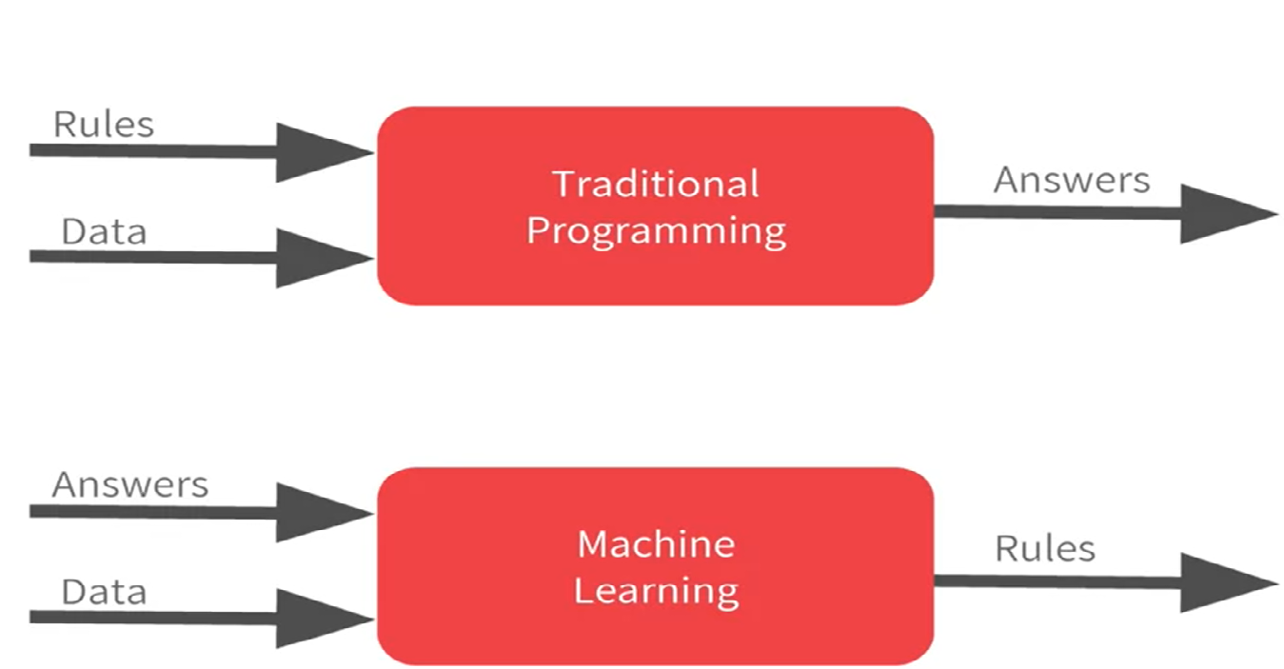
Why ML: From Rules to Data

Slide 3
Exercise
Input: 1 | 2 | 3 | 4 | 5 | 6
Output: 1 | 3 | 5 | 7 | 9 | ?
Input = 6 -> Output = ?
Output = 11
y = 2x - 1
Input: 1 | 2 | 3 | 4 | 5 | 6
Output: 3 | 8 | 15 | 24 | 35 | ?
Input = 6 -> Output = ?
35
y = x*(x+2)
Notes:
No improvement in the performance -> no learning

Slide 4
What is Machine Learning?
Term “Machine Learning” coined by Arthur Samuel in 1959.
Samuel Checkers-playing Program
Common definition (by Tom Mitchell)
Machine Learning is the study of computer algorithms that improve automatically through experience
Study of algorithms that
improve their performance P
at some task T
with experience E
Well-defined learning task: <P,T,E>

Slide 5
Task (T)
Classification or Pattern Recognition
Regression or Prediction
Clustering
Synthesis or Sampling
Ranking
Recommendation Systems
Anomaly Detection
Data Mining etc.
Notes:
Weather Forecasting vs Temperature prediction

Slide 6
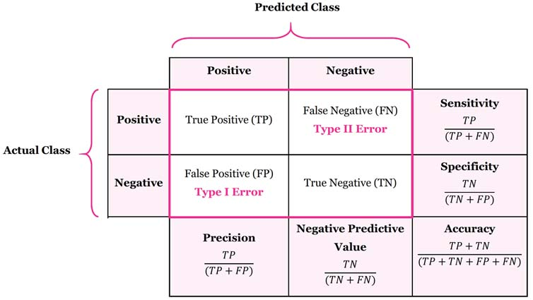
Performance (P)
A quantitative measure to evaluate performance
Usually Task specific
Classification
Accuracy or Error Rate
= (TP+TN)/(TP+FP+FN+TN)
Notes:
Actual Class and Predicted Class
Line for points

Slide 7
Experience (E): Types of ML
Supervised Learning
Labelled data – (Data, target value)
Target value could be category/class labels, real value, real vector, etc.
Classification, Regression
Unsupervised Learning
Only data, no labels
Dimensionality Reduction, ICA, Clustering
Reinforcement Learning
No examples, but a reward function
Payoff based on actions
Notes:
Supervised: Spam Detection
Unsupervised: Baby in mother’s womb - heart beats
Reinforcement: Baby with remote control

Slide 8
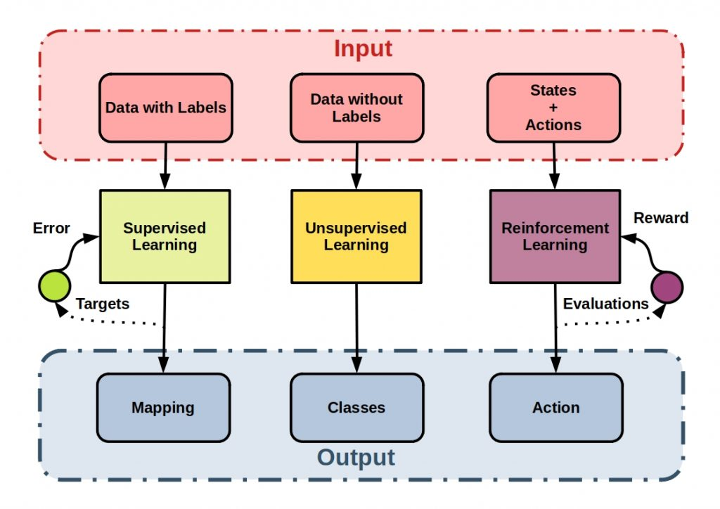
Supervised vs Unsupervised vs RL
Notes:
L measures how good we are on a particular input value x

Slide 9
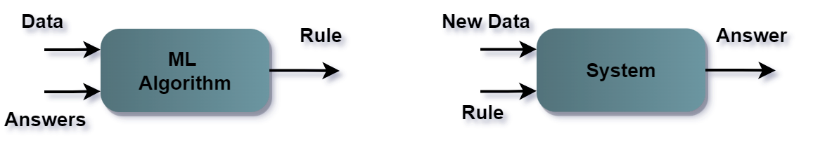
Training and Testing
Training Phase
Testing/Deployment Phase
Notes:
No improvement in the performance -> no learning

Slide 10
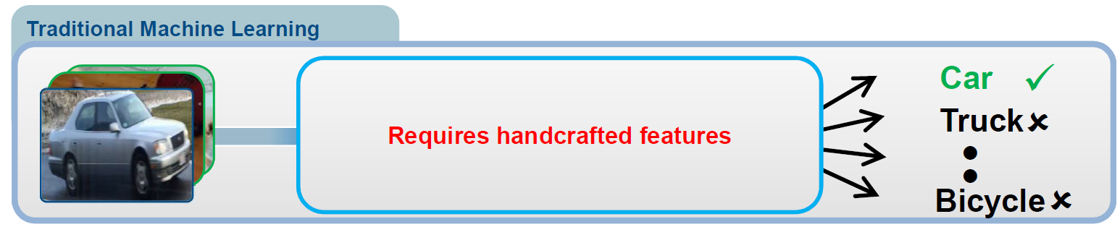
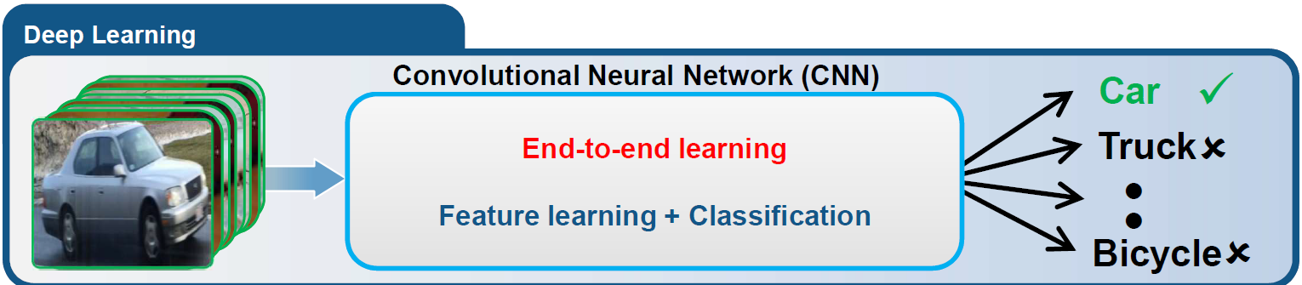
ML vs DL

Slide 11
When to avoid ML?
Simple or deterministic problems: If the problem can be solved through simple rules or deterministic algorithms, then ML may not be necessary.
Insufficient or poor quality data: If the data is incomplete, noisy, biased, or of poor quality, then the ML model may not be effective or may produce inaccurate or biased results.
When the cost of errors is high: Machine learning models are not perfect, and they can make mistakes. For example, diagnosis of medical conditions.
Lack of interpretability: Some ML models, such as deep neural networks, can be difficult to interpret. This can be problematic in situations where it is important to understand how the model is making decisions.
Notes:
Supervised: Spam Detection
Unsupervised: Baby in mother’s womb - heart beats
Reinforcement: Baby with remote control

Slide 12
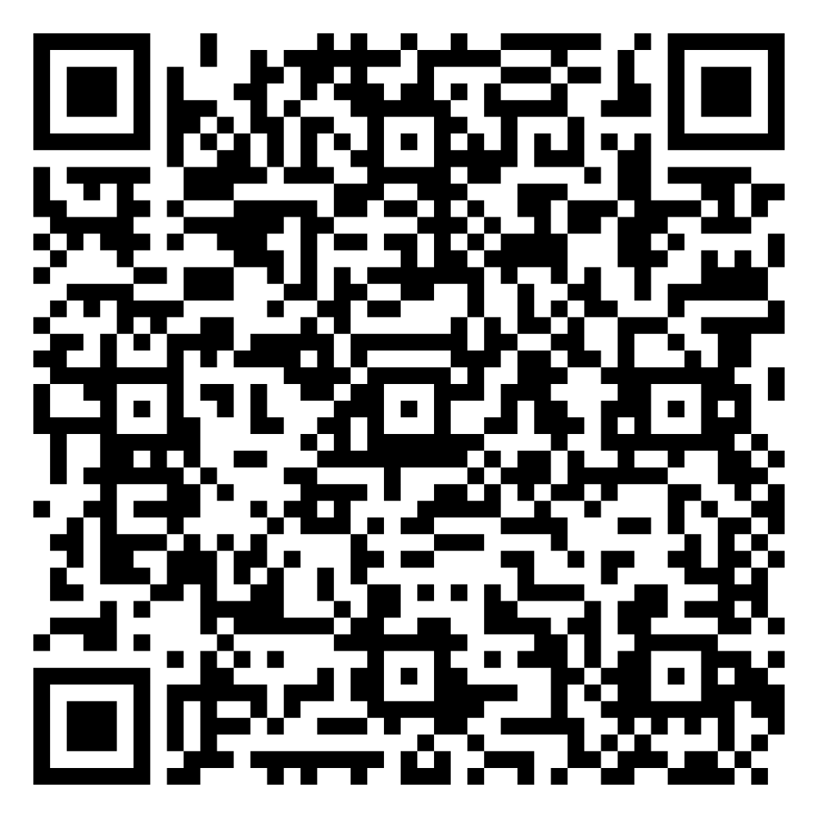
4.1 Quiz

Slide 13
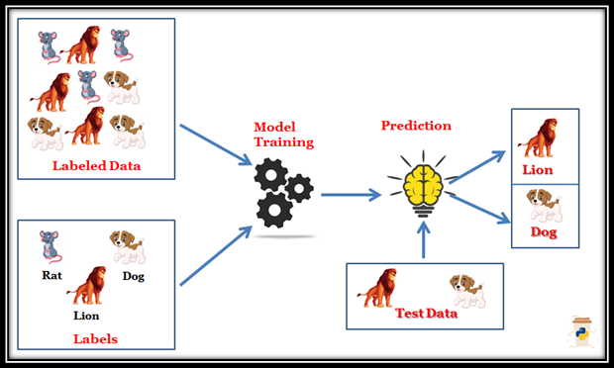
Supervised Learning
Notes:
L measures how good we are on a particular input value x

Slide 14
Supervised Learning
An algorithm is trained on a labeled dataset, where each input data point is associated with a corresponding output value or label.
D = {(x₁, y₁), (x₂, y₂), …, (x_{n}, y_{n})}
The goal is to learn a mapping function that can predict the output value for new, unseen input data points.
f : X -> Y
Input: Training examples {<x_{i},y_{i}>}
Output: Unknown target function f : X -> Y as distribution P(y/x)
Set of function hypotheses H={ h | h : X->Y }
Examples:
Classification: The input data is assigned to a category or class, such as whether an email is spam or not.
Regression: The output value is a continuous variable, such as predicting the price of a house based on its features.
Notes:
L measures how good we are on a particular input value x

Slide 15

Learning Process
The learning problem is to choose h from the given set of functions the one which best approximates the supervisor’s response.
The selection is based on training samples
Note: Picking the function f (via hypothesis h) that minimizes the empirical risk is known as empirical risk minimization!
Input: Training examples {<x_{i},y_{i}>}
Output: Hypothesis h ∈ H that best approximates target function f

Slide 16
How to choose h?
Randomly:
Advantage: Really fast
Disadvantage: Terrible performance
Scan entire H and pick the best:
Advantage: Great performance
Disadvantage: Terribly slow
Intelligent Way: Learn it using the performance metric
Loss functions help to evaluate the performance of the h_{i}’s ∈ H to identify the optimal h.
Notes:
L measures how good we are on a particular input value x

Slide 17


Loss Functions
To choose the best function f, it makes sense to minimize a loss (or cost or discrepancy) between the response of the supervisor and the learning machine, given an input (x, y)
We want to minimize the loss over all samples
Loss functions are always non-negative.
Hence, minimum possible loss means we are not making any mistakes.
Notes:
L measures how good we are on a particular input value x

Slide 18
Empirical Risk Minimization Principle
How much data we have: For any given function f, as we get more and more data, we can expect that R(f) → R_{true}(f)
The true distribution p: Depending on how “complex” the true distribution is, more or less data may be necessary to get a good approximation of it.
The loss function L: If the loss function is very “weird”– giving extremely high loss in certain unlikely situations, this can lead to trouble.
The class of functions F: Roughly speaking, if the size of F is “large”, and the functions in F are “complex”, this worsens the approximation, all else being equal.

Slide 19
Few Supervised Learning Algorithms
Classification:
Decision Trees: A tree-based model that splits the input data into smaller subsets based on the values of different features, and makes a prediction based on the final subset.
Support Vector Machines (SVM): A model that finds the optimal hyperplane that separates the input data into different classes.
Neural Networks: A model that consists of multiple layers of interconnected neurons, and is capable of learning complex, non-linear mappings between the input and output data.
Regression:
Linear Regression: A linear model that seeks to fit a straight line to the input data that minimizes the difference between the predicted and actual output.
Polynomial Regression: A non-linear model that fits a polynomial function to the input data, allowing for more complex relationships between the input and output variables.
Support Vector Regression (SVR): A model that seeks to find the optimal hyperplane that separates the input data into different classes while minimizing the difference between the predicted and actual output values.
Notes:
L measures how good we are on a particular input value x

Slide 20
Example of SL
Email spam detection: A supervised learning algorithm can be trained on a dataset of labeled emails, where each email is labeled as either spam or not spam, and can then be used to classify new, unseen emails as spam or not spam.
Medical diagnosis: A supervised learning algorithm can be trained on a dataset of labeled medical images or patient data, where each example is labeled as having a particular disease or not, and can then be used to predict the likelihood of a patient having a disease based on their symptoms or test results.
Autonomous driving: A supervised learning algorithm can be trained on a dataset of labeled images and sensor data, where each example is labeled with the correct driving behavior, such as turning or braking, and can then be used to control a self-driving car in real-world scenarios.
https://x.com/vikataravi/status/1752126547765678387?s=20
Notes:
L measures how good we are on a particular input value x

Slide 21
Advantages and Disadvantages of SL
Advantages:
Can be used to solve a wide range of tasks, from simple classification to complex image and speech recognition.
Provides good predictions on new, unseen data points.
Allows for easy evaluation and comparison of different models using metrics such as accuracy and precision.
Disadvantages:
Requires a large amount of labeled data for training, which can be time-consuming and expensive to obtain.
May suffer from overfitting if the model is too complex and the dataset is too small.
May not perform well on data points that are very different from the training data, or on data with noisy or missing features.
Notes:
L measures how good we are on a particular input value x

Slide 22
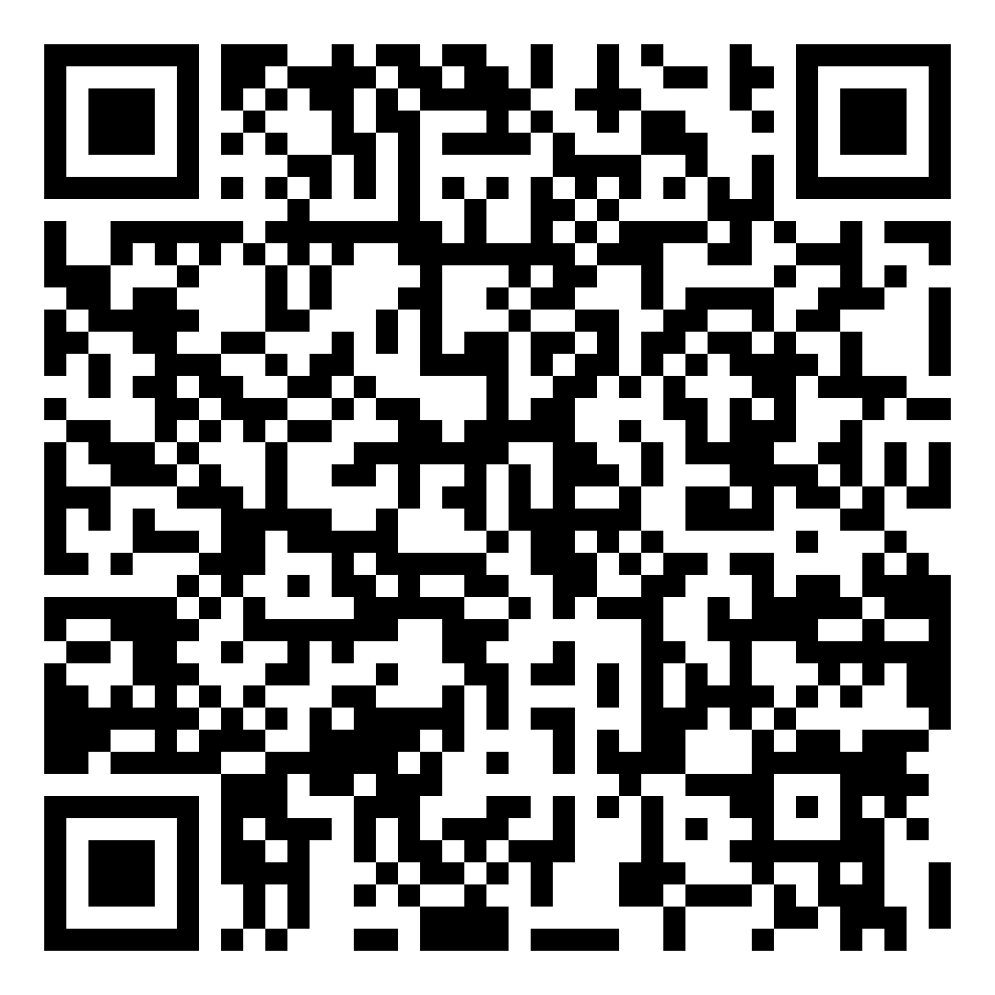
4.2 Quiz

Slide 23
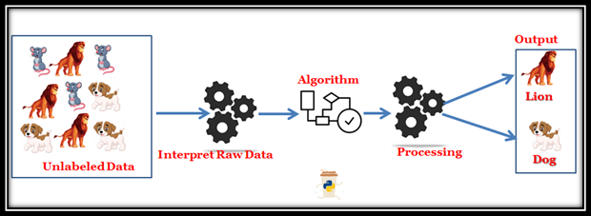
Unsupervised Learning
An algorithm is trained on a dataset which is not labeled
D = {(x₁), (x₂), …, (x_{n})}
The goal is to find patterns or structure in the data without explicit guidance or supervision.
f : X -> Z
Z is the learned representation or structure of the input data.
A form of exploratory data analysis, where the goal is to discover hidden patterns or relationships in the data.
Notes:
L measures how good we are on a particular input value x

Slide 24
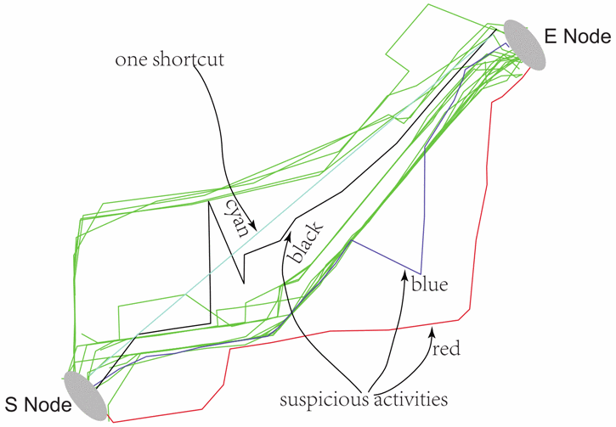
An interesting Use Case: Fraudulent Driving
A Taxi Driving Fraud Detection System

Slide 25
Few Unsupervised Learning Algorithms
Clustering: Grouping similar data points together based on their similarity or distance in the feature space.
K-means clustering: A popular algorithm for clustering data points based on their similarity.
Dimensionality reduction: Reducing the number of features in the data while preserving the most important information.
Principal Component Analysis (PCA): An algorithm for reducing the dimensionality of data by projecting it onto a lower-dimensional space.
Autoencoder: A neural network architecture that can be trained to learn a compressed representation of the data.
Notes:
L measures how good we are on a particular input value x

Slide 26
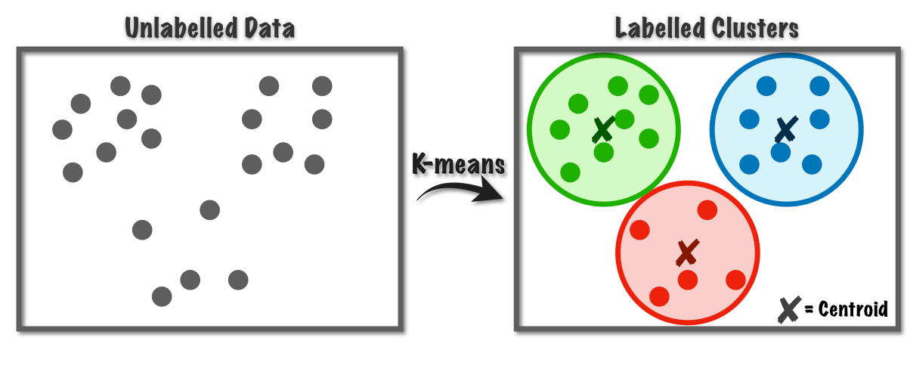
K-Means

Slide 27
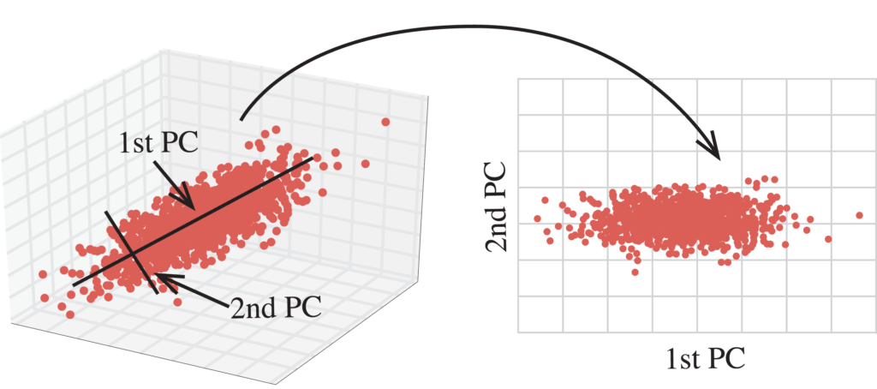
PCA

Slide 28
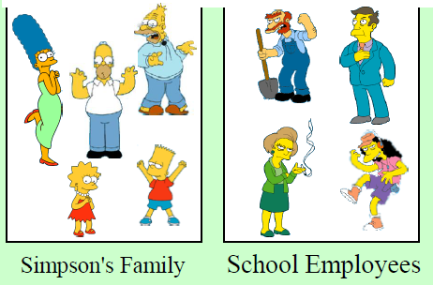
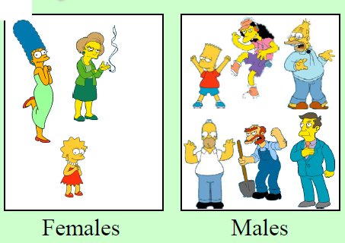
Natural grouping : Clustering is subjective

Slide 29
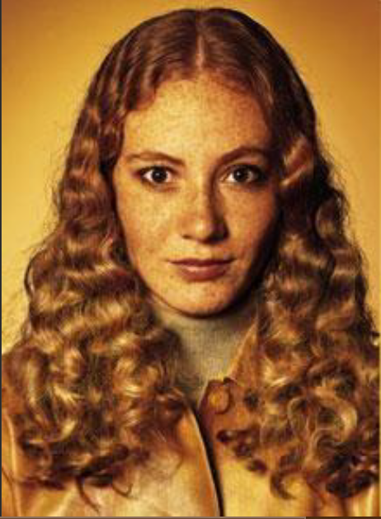

What is Similarity?

Slide 30
Examples of Unsupervised Learning in IS
In a customer segmentation task, K-means clustering can be used to group customers into different segments based on their purchasing behavior, demographics, or other features. The algorithm would automatically group customers with similar characteristics together, without the need for explicit labels or annotations.
Autoencoders can be used for tasks such as image denoising, feature extraction, or data compression. For example, in image denoising, an autoencoder can be trained to remove noise from images by learning a compressed representation of the image that captures the underlying structure of the image.
Notes:
L measures how good we are on a particular input value x

Slide 31
Advantages and disadvantages
Advantages:
Can be used to find hidden patterns and relationships in data that may not be apparent using other methods.
Can be applied to a wide range of data types and formats, including text, images, and numerical data.
Can be used to preprocess data for further analysis or classification.
Disadvantages:
Results may be difficult to interpret or validate, since there is no explicit guidance or supervision.
Performance can be sensitive to the choice of algorithm and parameters.
Can be computationally expensive for large datasets or high-dimensional data.
Notes:
L measures how good we are on a particular input value x

Slide 32
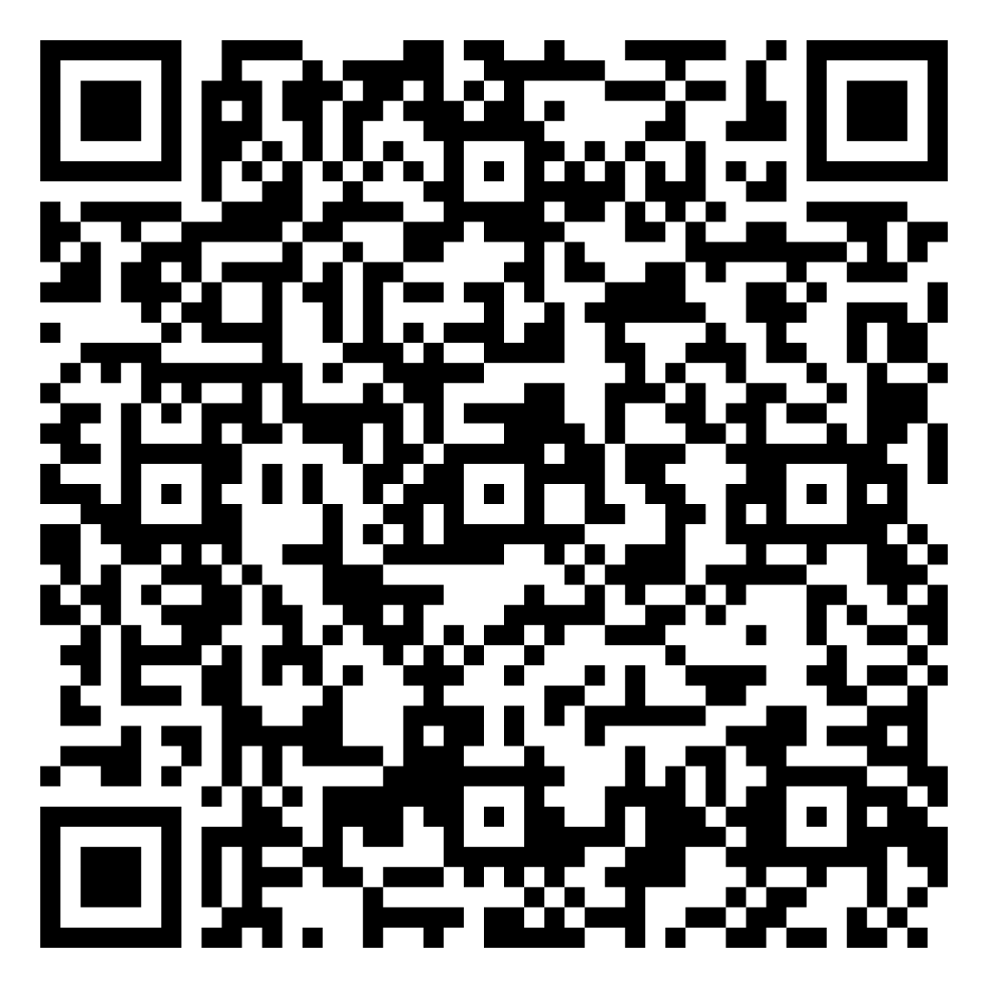
4.3 Quiz

Slide 33
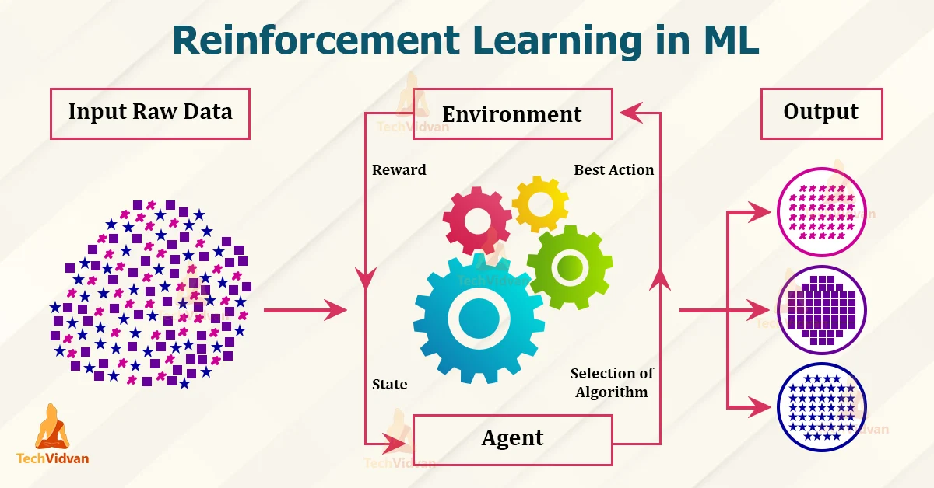
Reinforcement Learning
Involves an agent interacting with an environment, learning to make decisions that maximize a reward signal.
The goal is to to learn a policy that maps states to actions, in order to maximize a reward signal over time.
Examples:
In game AI, to train agents to play games such as Go, Chess, and Poker.
In recommendation systems, to personalize recommendations for users, taking into account their past behavior and preferences.
Notes:
L measures how good we are on a particular input value x

Slide 34
Few RL Algorithms
Q-Learning: An off-policy algorithm that learns the optimal Q-value function for a given policy, and then uses this function to choose the best action at each step.
SARSA: An on-policy algorithm that learns the Q-value function for the current policy, and updates the policy based on the Q-values.
Deep Q-Networks (DQN): A deep reinforcement learning algorithm that uses a deep neural network to estimate the Q-value function, and applies experience replay to improve stability and sample efficiency.
Notes:
L measures how good we are on a particular input value x

Slide 35
Advantages and disadvantages
Advantages:
Ability to learn from experience: RL allows agents to learn from their interactions with the environment, making it well-suited to applications where the optimal solution is not known in advance.
Flexibility: RL can handle complex, dynamic, and uncertain environments, making it a powerful tool for applications such as robotics and game AI.
Generalization: RL can learn to generalize from experience, enabling agents to perform well in new situations that were not encountered during training.
Disadvantages:
High sample complexity: RL can require a large number of interactions with the environment to learn an optimal policy, which can be time-consuming and computationally expensive.
Risky behavior: RL agents can learn to take risky actions to maximize rewards, which can be undesirable in applications such as healthcare and finance.
Notes:
L measures how good we are on a particular input value x

Slide 36
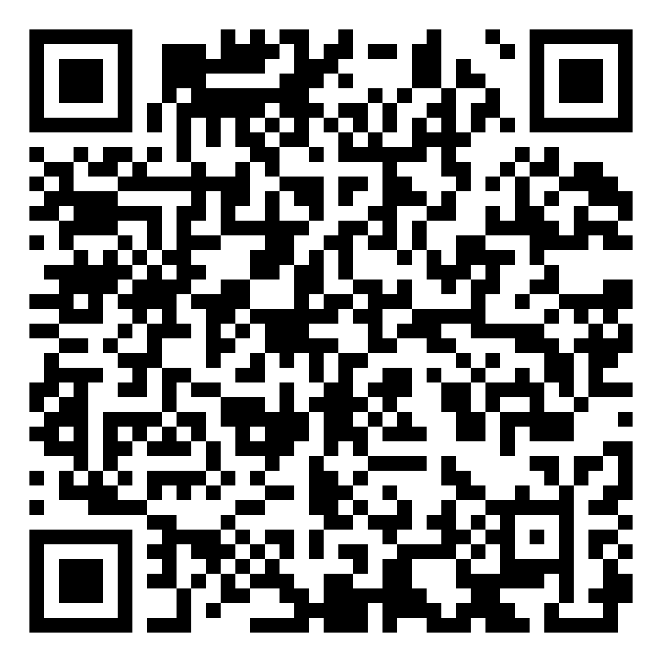
4.4 Quiz

Slide 37
Factors affecting ML type
Task requirements: The nature of the task, such as whether it involves classification, regression, clustering, or prediction.
Data availability:
Supervised learning requires labeled data, which may not be available or may be costly to obtain.
Unsupervised learning can work with unlabeled data, but may require more data to achieve good results.
Reinforcement learning requires an environment to interact with, which may be difficult or expensive to simulate.
Computational resources: The computational resources required for different machine learning types can vary significantly.
For example, deep neural networks can be computationally intensive, while k-means clustering may be less demanding.
Interpretability: If interpretability is important, simpler and more transparent supervised models may be preferred.
Performance requirements: Different ML algorithms may have different performance characteristics, e.g. speed, accuracy, scalability.
Notes:
L measures how good we are on a particular input value x

Slide 38
Putting it all together!
Let's consider the problem of developing an intelligent virtual assistant for a healthcare provider. The assistant should be able to identify symptoms and suggest appropriate treatment options for patients.
Where do you think all three types of ML algorithms can be used?
Supervised Learning could be used to train the system on labeled data of symptoms and treatments. The system could learn to predict the appropriate treatment based on the patient's symptoms and medical history.
Unsupervised Learning could be used to identify patterns and relationships in patient data, such as identifying clusters of patients with similar symptoms or medical conditions.
Reinforcement Learning could be used to train the system to interact with patients in a natural and empathetic manner, using feedback from patients and medical professionals to improve its responses over time.
Notes:
L measures how good we are on a particular input value x

Slide 39


